Slide 1
Image Processing

Slide 2
agenda
Introduction
Purpose
Programming Language
Features
Technologies Used
Struggle

Slide 3
A Project of Processing Image

Slide 4
Purpose
To provide a graphical user interface (GUI) for performing basic image processing tasks.

Slide 5
Programming Language
Java

Slide 6
Features
Load, display, and resize images to fit within 400x400 dimensions.
Apply filters (e.g., grayscale) to enhance or modify the image appearance.
Perform transformations, such as rotating the image by 90 degrees.
Save the processed image to a user-defined location.

Slide 7
Technologies Used
Swing Framework: For building the GUI.
BufferedImage: For image manipulation.
File I/O: For loading and saving images using a file chooser dialog.
Custom Resizing: Ensures images fit a 400x400 dimension while maintaining aspect ratio

Slide 8
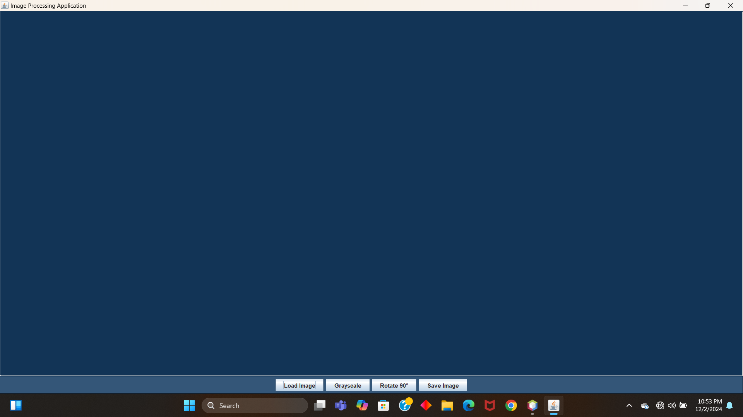
OUtputs
1. Running the main class

Slide 9
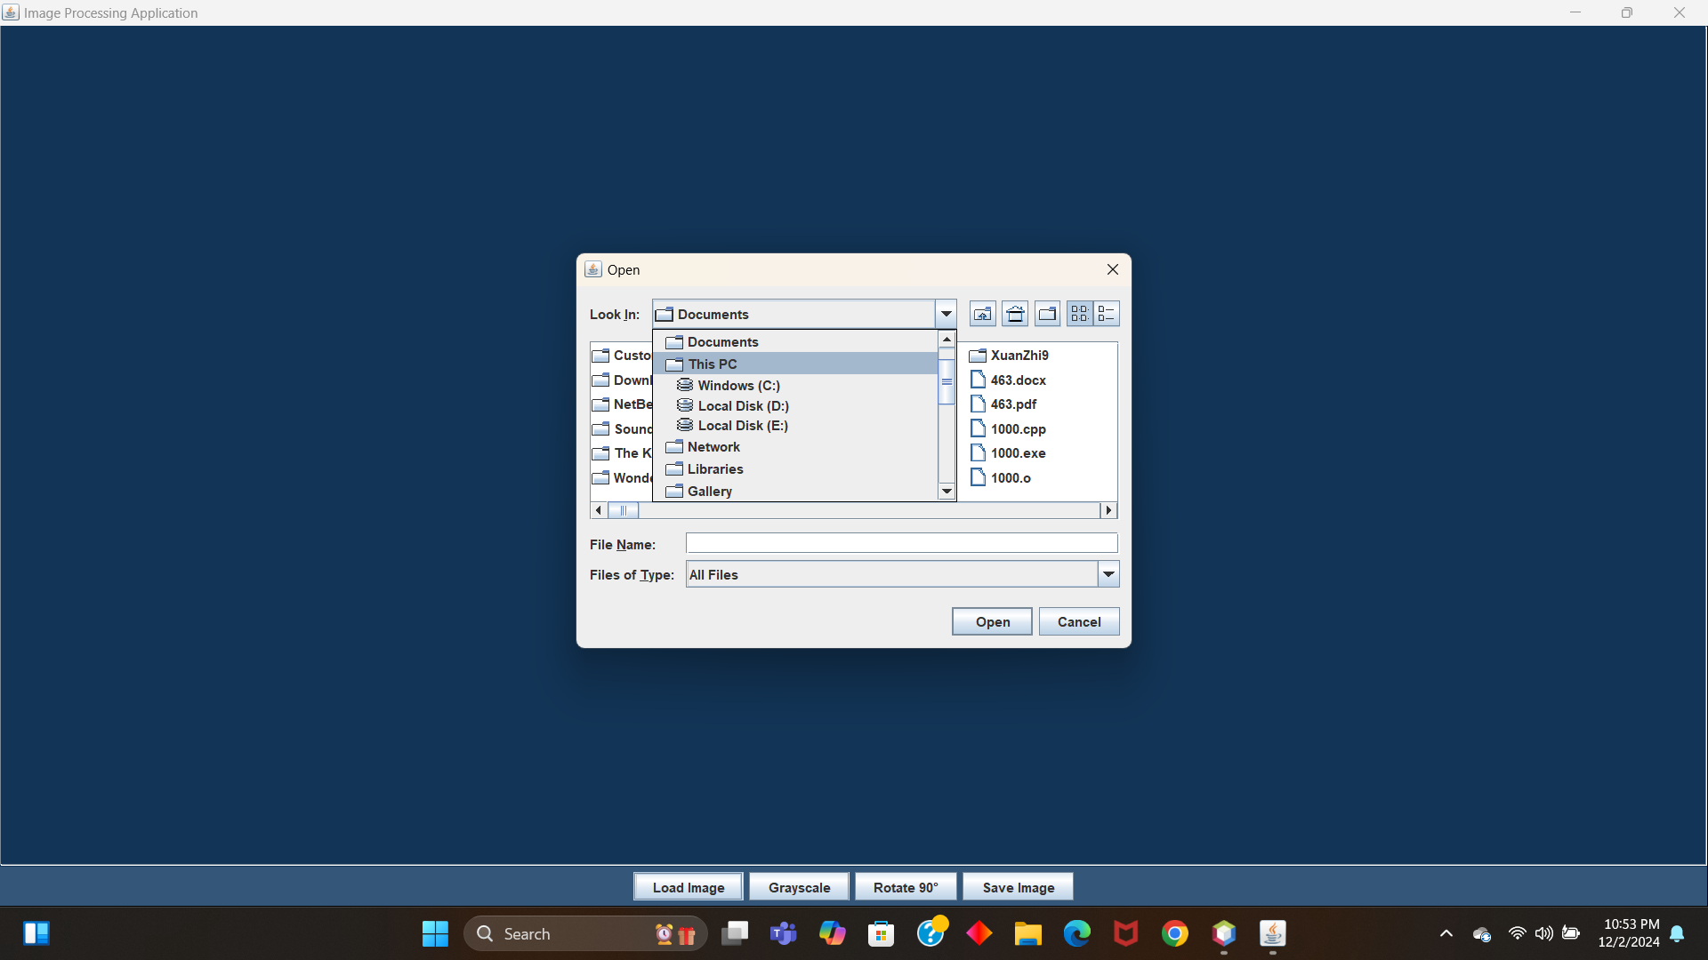
Loading Image Option:

Slide 10
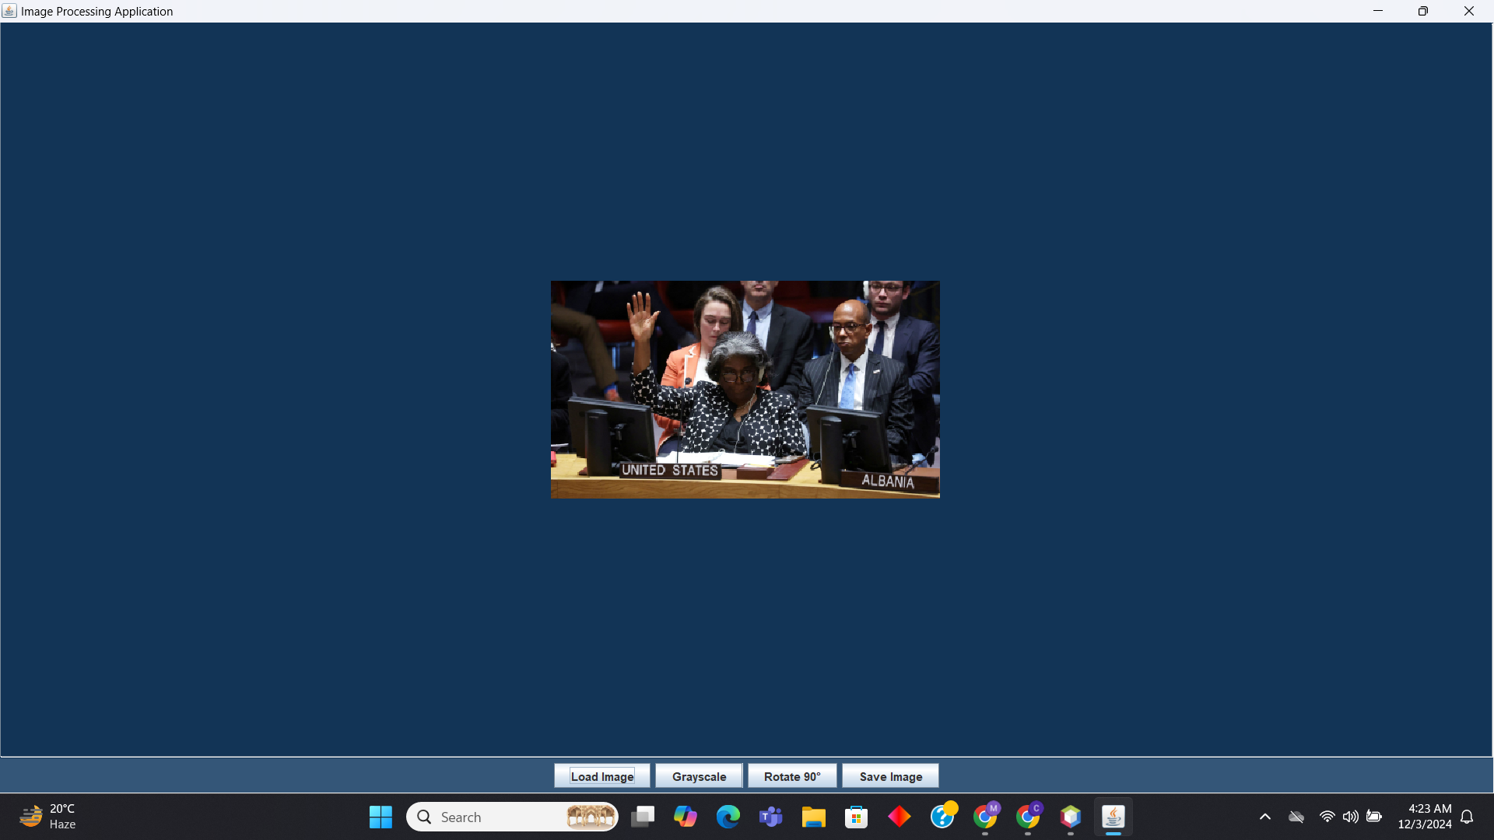
Image Projection:

Slide 11
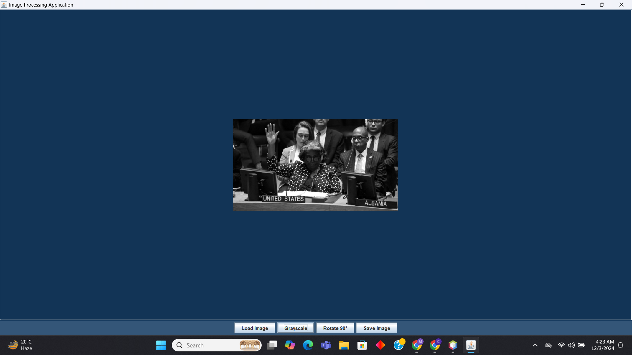
Applying Grayscale:

Slide 12
Strugle
if (imageEditor != null) { imageEditor.applyFilter(filterType); currentImage = imageEditor.getImage(); imageLabel.setIcon(new ImageIcon(currentImage)); } else {
First error occurd at here. Then I implement at else block
if (imageEditor != null) {
System.out.println("Applying filter: " + filterType);
imageEditor.applyFilter(filterType);
currentImage = imageEditor.getImage();
if (currentImage != null) {
imageLabel.setIcon(new ImageIcon(currentImage));
} else {
System.err.println("Error: currentImage is null after applying the filter.");
}
} else {
System.err.println("Error: imageEditor is null.");
}

Slide 13
Then When I Load any image ,the window was becoming huge.I set it at 400dp by these code.
/////////////////
private BufferedImage resizeImage(BufferedImage originalImage, int targetWidth, int targetHeight) {
Image scaledImage = originalImage.getScaledInstance(targetWidth, targetHeight, Image.SCALE_SMOOTH);
BufferedImage resizedImage = new BufferedImage(targetWidth, targetHeight, originalImage.getType());
Graphics2D g2d = resizedImage.createGraphics();
g2d.drawImage(scaledImage, 0, 0, null);
g2d.dispose();
return resizedImage;
}
///////////////////////////////////
private class LoadImageAction implements ActionListener {
@Override
public void actionPerformed(ActionEvent e) {
JFileChooser fileChooser = new JFileChooser();
int result = fileChooser.showOpenDialog(null);
if (result == JFileChooser.APPROVE_OPTION) {
File file = fileChooser.getSelectedFile();
currentImage = ImageIOHandler.loadImage(file.getAbsolutePath());
if (currentImage != null) {
// Resize the image to 400dp (or pixels)
int targetSize = 400;
int width = currentImage.getWidth();
int height = currentImage.getHeight();
if (width > targetSize || height > targetSize) {
float aspectRatio = (float) width / height;
if (aspectRatio > 1) {
// Landscape image
currentImage = resizeImage(currentImage, targetSize, (int) (targetSize / aspectRatio));
} else {
// Portrait or square image
currentImage = resizeImage(currentImage, (int) (targetSize * aspectRatio), targetSize);
}
}
imageEditor = new ImageEditor(currentImage);
imageLabel.setIcon(new ImageIcon(currentImage));
pack();
} else {
JOptionPane.showMessageDialog(null, "Error loading image.");
}
}
}
}

Slide 14
After that When the rotation part was performing every image didn’t stay steady in the frame. For that modified Apply transformation part.
private class ApplyTransformationAction implements ActionListener {
private String transformationType;
public ApplyTransformationAction(String transformationType) {
this.transformationType = transformationType;
}
@Override
public void actionPerformed(ActionEvent e) {
if (imageEditor != null) {
imageEditor.applyTransformation(transformationType);
currentImage = imageEditor.getImage(); // Resize image to fit in 400dp after rotation if necessary int targetSize = 400; int width = currentImage.getWidth(); int height = currentImage.getHeight();
if (width > targetSize || height > targetSize) {
float aspectRatio = (float) width / height;
if (aspectRatio > 1) {
// Landscape image
currentImage = resizeImage(currentImage, targetSize, (int) (targetSize / aspectRatio));
} else {
// Portrait or square image
currentImage = resizeImage(currentImage, (int) (targetSize * aspectRatio), targetSize); } } imageLabel.setIcon(new ImageIcon(currentImage)); // Repack and re-center the frame pack(); setLocationRelativeTo(null); // Centers the window on the screen } else { JOptionPane.showMessageDialog(null, "Please load an image first."); } } }

Slide 15
After that I tried to fix that problem in many ways. But I can’t. Still the problem is happening.
At last I decorate the frame of GUI and make it colourful by setBackground.

Slide 16
Thank you

